Slide 1

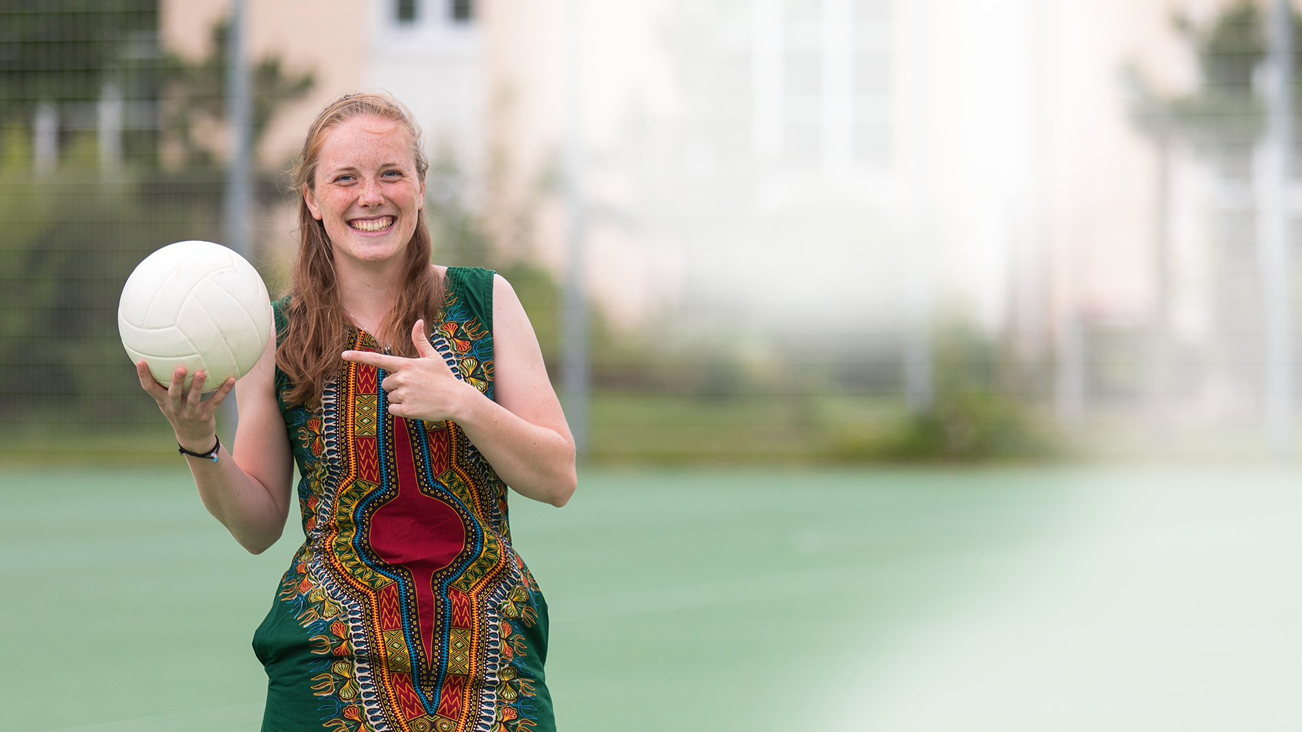
Results
DON BOSCO
VOLUNTEERS
SURVEY
on the occasion of the 25th anniversary

Slide 2
WE
For 25 years, we have been sending volunteers to our youth welfare institutions worldwide, e.g. youth centres, orphanages, residential homes and schools. Fields of activity are leisure activities such as sports and games, everyday care.
Countries are Colombia, Bolivia, Argentina, Togo, Benin, Zambia, Uganda, Rwanda, Malawi, India, Albania and many more.
The volunteers are mostly between 18 and 20 years old and receive an intensive 8-month preparation for their one-year service abroad.
Since 2008, we have been partly funded by the weltwärts programme of the Federal Ministry for Economic Cooperation and Development and have been awarded the RAL seal of quality since
www.donboscovolunteers.de

Slide 3
EVALUATION ON THE OCCASION OF 25 YEARS OF DON BOSCO VOLUNTEERS
In the 25 years of our existence, the voluntary service has constantly changed and developed.
We have taken stock to find out how long-lasting the voluntary service has shaped the lives of the young people and what experiences they have taken with them in retrospect, whether there have been long-term changes in behaviour and attitudes, and also what has remained particularly memorable from the time.
www.donboscovolunteers.de

Slide 4
STATISTICAL DATA
We sent the survey by mail to 650 recipients.
The survey was anonymous and has been conducted via Google Forms in March/April 2021.
We received and evaluated 180 responses.
Participants were alumni from the years 1996 - 2019. 30% of the participants had completed their voluntary service more than 6 years ago, 15% even more than 10 years ago.
1/3 of the participants are male, 2/3 female, this also corresponds to the distribution of our volunteers as a whole.
www.donboscovolunteers.de

Slide 5
RESULTS
Volunteer service has a lasting and profound impact on the lives of young people. For years after the assignment, especially after the deployment, volunteers maintain contact with the host country and are highly sensitized to issues such as racism, privilege and postcolonialism.
Volunteering in a development context changes consumption habits and encourages a critical look at international trade and economic structures and social injustice.
Volunteer service increases interest in politics.
Working with children and young people shapes career and study choices, 1/3 of the volunteers choose to study education or similar.
www.donboscovolunteers.de

Slide 6
RESULTS
The experience of being part of an international community for the benefit of children and young people is perceived by the participants as meaningful, positive and personally enriching - consistently much praise for Don Bosco as organization.
Voluntary service does not end after one year, volunteers are highly committed to voluntary work - even years after their own commitment.
The intensive experience of being part of a religious community is predominantly perceived positively. However, more trust in the church as an institution and an intensification of one's own faith do not necessarily go hand in hand with this.
www.donboscovolunteers.de

Slide 7
PERSONALITY DEVELOPMENT
80% and more
feel strengthened for later challenges and crises,
have more self-confidence and
have become freer and more open in thinking and acting
www.donboscovolunteers.de

Slide 8
TESTIMONIES OF VOLUNTEERS
"A lot was triggered in me for personal development - the experience is not finished yet."
"The attitude towards fellow human beings and the disadvantaged, which I also developed or deepened during my voluntary service, has become my inner moral compass.“
"The volunteer service has definitely left a lasting and, above all, positive mark on me. In my life, I always come back to experiences I gained there.“
"I try to enjoy every day and be more spontaneous."
www.donboscovolunteers.de

Slide 9
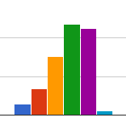
CONSUMPTION BEHAVIOR
64% of respondents pay more attention to their consumer behavior and sustainability since volunteering
74 % have learned to appreciate the simplicity of life
Since my voluntary service I have been paying more attention to my consumer behavior
www.donboscovolunteers.de

Slide 10
STATEMENTS ON VOLUNTARY CONSUMPTION
"I'm more grateful for everything I have and don't always look for the 'more'."
"I've become more minimalist and appreciate openness more, and I feel like I understand the thinking of other cultures a little better."
"I have learned to appreciate living with few things and more encounters instead."
www.donboscovolunteers.de

Slide 11

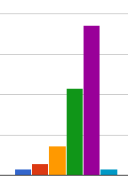
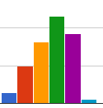
COLONIALISM AND RACISM
64% of respondents pay more attention to their consumer behavior and sustainability since the volunteer service
> 80% indicated to question racism and racist structures, globalization and worldwide relations more critically and to react more sensitively to stereotypes and prejudices
75 % indicated that injustice and unjust structures challenged them
58 % indicated that their interest in politics had increased
Mein Interesse an Politik ist gestiegen
Rassismus und rassistische Strukturen hinterfrage ich häufiger
www.donboscovolunteers.de

Slide 12
TESTIMONIES OF VOLUNTEERS
"It has made me more aware of colonialist structures. I've become more careful about making snap judgments."
"I became, and to this day still become, acutely aware of my privileged status as a German."
"The volunteer service sensitized me to question international inequalities and unjust structures more and contributed to my decision to take more courses in this direction within my studies and to continue to engage in some of my free time."
www.donboscovolunteers.de

Slide 13
FIELD OF STUDY AND CAREER CHOICE
33% have chosen to study in the field of education following their voluntary service.
33% have chosen to study business and engineering following their voluntary service.
50% of respondents said they had been influenced by their volunteer service in their choice of career or course of study.
www.donboscovolunteers.de

Slide 14
FIELD OF STUDY AND CAREER CHOICE
www.donboscovolunteers.de

Slide 15
VOLUNTEER ACTIVITIES
91% indicated that they were active as volunteers,
50% even once per week.
Most common activities:
• in children's and youth work
• in church and community work,
• in refugee work,
• in the field of development policy,
• in climate protection and
• at Don Bosco.
How long ago the volunteer service took place and whether the volunteers were male or female made no difference to the figures.
www.donboscovolunteers.de

Slide 16

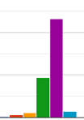


DON BOSCO, FAITH AND WORK WITH CHILDREN
85% experienced Don Bosco as a community in a predominantly positive way.
50% indicate that personal faith has been strengthened
I have experienced church and faith positively
The volunteer service has strengthened my personal faith
The fate of children and young people has moved me / made me think.
www.donboscovolunteers.de

Slide 17
TESTIMONIES OF VOLUNTEERS
"Religion has become more important to me."
"Working with the kids was great!"
"Above all, I question the institutions of faith more. [...] I now believe above all without the church."
"Before and after volunteering, it's the great Don Bosco Volunteers community that you find in all cities in Germany and whether you know the volunteers or not, it feels like one big family."
"While the church connection itself wasn't particularly important to me, the values that the Salesians of Don Bosco impart are all the more important."
www.donboscovolunteers.de

Slide 18
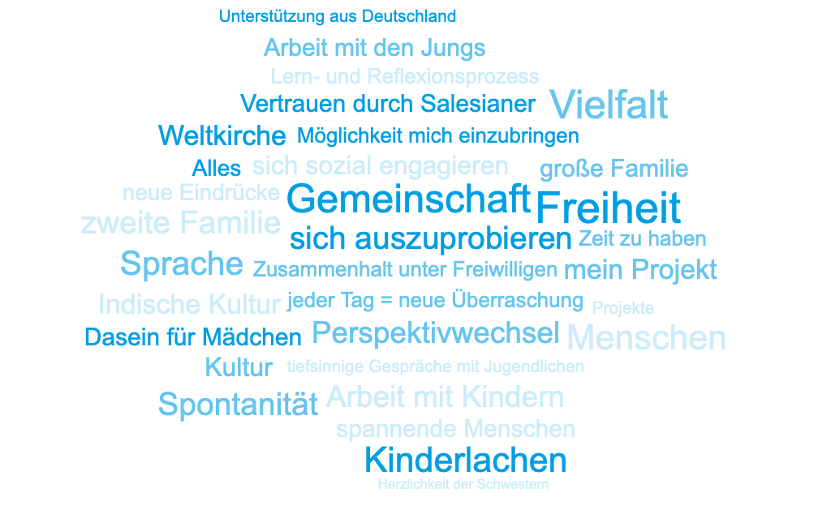
What I liked most about my volunteer service was ...
www.donboscovolunteers.de

